Slide 1
Individual-based models & Spatially explicit individual-based models with NetLogoR
21-22 Juin 2021

Slide 2
NetLogoR

Slide 3


What is NetLogoR?
NetLogo in R
« NetLogo is a multi-agent programmable modeling environment.»
R package to create and run IBMs in R
Translation of NetLogo, does not call the software!
Bauduin et al., 2019
Wilensky, 1999

Slide 4
Why NetLogoR?
Benefits of NetLogo
Efficient framework
Easy and fast learning
Benefits of R
From managing data and inputs to analyze outputs in R
Reduce mental switching cost between software
Access to lots of packages and functions
Can use multiple classes
Raster, shapefile, list, dataframe, …
Bauduin et al., 2019
Wilensky, 1999

Slide 5

NetLogoR
https://doi.org/10.1111/ecog.04516

Slide 6
NetLogoR
Available on CRAN
install.packages("NetLogoR")
And on GitHub
install.packages("devtools") devtools::install_github("PredictiveEcology/NetLogoR")
https://github.com/PredictiveEcology/NetLogoR
Issues can be opened
Google group for users
https://groups.google.com/g/netlogor

Slide 7
Let’s start coding some IBM

Slide 8
Forest model
Create a forest with trees
Trees grow (aging process)
Some trees are cut (mortality process)
Demo in R
File: 1_ForestModel.R

Slide 9
Population model
Create a population of mouse
Move the mice around (movement process)
Mice age (aging process)
Some reproduce (reproduction process)
Some die (mortality process)
Demo in R
File: 2_PopulationModel.R

Slide 10
NetLogoR in details

Slide 11
NetLogoR
Provides new classes
Landscapes
worldMatrix and worldArray
Landscape cells are « patches »
Mobile agents
agentMatrix (faster version of SpatialPointsDataFrame)
Called « turtles »
And functions
Movement
Landscape/individual interactions
Population dynamics
…

Slide 12
Main steps to build an IBM with NetLogoR
Draw the model diagram to define the workflow and identify the different processes and their relationships.
Create the world in which the agents will evolve with the function createWorld() and assign patch values if necessary. Visualize the world with plot(nameWorld).
Create the turtles (i.e., moving agents) with the function createTurtles(). Visualize the turtles by plotting them on the world with points(nameTurtles).
Create the different processes (i.e., functions affecting the patches and/or turtles) by using the NetLogoR functions, the R functions or some from other packages.
Don’t hesitate to use help() to understand how NetLogoR functions and their arguments work. Don’t hesitate to look at the list of NetLogoR functions to find a function which already does what you want to do.
Test the different processes individually with a small world and a few numbers of turtles to make sure the code is doing what you want it to do.
Plot regularly to make sure the code is doing what you want it to do. Visuals are of great help to spot bugs in model. Also display elements (what’s inside the world and the turtles objects) regularly.
Then, build the main procedure for the model (e.g., with a for-loop or a scheduler function). The functions placed inside the for-loop or the scheduler function will be iterated the number of time steps defined.
Create test units to check if there are some bugs and to locate them easily. Use browser() when debugging.
Visuals can be plotted at each time step and/or at the end when the iterations are over. Plot functions take time to be executed and slow down the model but they are of great help.

Slide 13
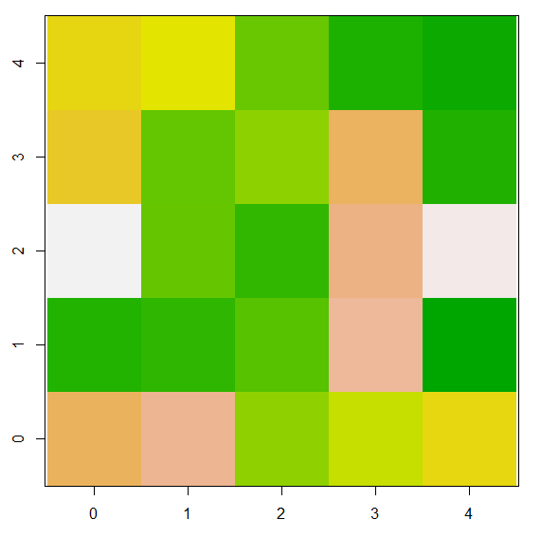
R classes for the landscape: worldMatrix and worldArray
A worldMatrix object can be viewed as a grid composed of squared patches (i.e., cells), a 2-dimensional landscape.
Patches have two spatial coordinates pxcor and pycor, representing the location of their center.
pxcor and pycor are always integer and increment by 1. pxcor increases as you move right and pycor increases as you move up.
pxcor and pycor can be negative if there are patches to the left or below the patch[0,0].
worldMatrix do not have coordinate systems.
worldMatrix can be viewed as a mix between a matrix and a RasterLayer

Slide 14
R classes for the landscape: worldMatrix and worldArray
Code available on R file: 3_NetLogoR.R
This is an extension of a matrix with 7 additional slots
> w1@minPxcor
[1] 0
> w1@maxPxcor
[1] 4
> w1@minPycor
[1] 0
> w1@maxPycor
[1] 4
> w1@extent
class : Extent
xmin : -0.5
xmax : 4.5
ymin : -0.5
ymax : 4.5
> w1@res
[1] 1 1

Slide 15
R classes for the landscape: worldMatrix and worldArray
Code available on R file: 3_NetLogoR.R
> w1@pCoords
pxcor pycor
[1,] 0 4
[2,] 1 4
[3,] 2 4
[4,] 3 4
[5,] 4 4
[6,] 0 3
[7,] 1 3
[8,] 2 3
[9,] 3 3
[10,] 4 3
[11,] 0 2
[12,] 1 2
[13,] 2 2
[14,] 3 2
[15,] 4 2
[16,] 0 1
[17,] 1 1
[18,] 2 1
[19,] 3 1
[20,] 4 1
[21,] 0 0
[22,] 1 0
[23,] 2 0
[24,] 3 0
[25,] 4 0

Slide 16
R classes for the landscape: worldMatrix and worldArray
Code available on R file: 3_NetLogoR.R
> w1@.Data
[,1] [,2] [,3] [,4] [,5]
[1,] 0.4763950 0.5136438 0.7306483 0.9009050 0.94322540
[2,] 0.4332253 0.7447880 0.6628346 0.3194291 0.89201067
[3,] 0.0410270 0.7383873 0.8514184 0.2501377 0.05842418
[4,] 0.8851923 0.8573701 0.7687598 0.2047619 0.97493443
[5,] 0.3244368 0.2263357 0.6574082 0.5615647 0.47929185
The methods [] and [] <- retrieve or assign values for the patches in the given order of the patches coordinates provided. When no patches coordinates are provided, the values retrieved or assigned is done in the order of the cell numbers as defined in in Raster* objects (i.e., by rows).

Slide 17
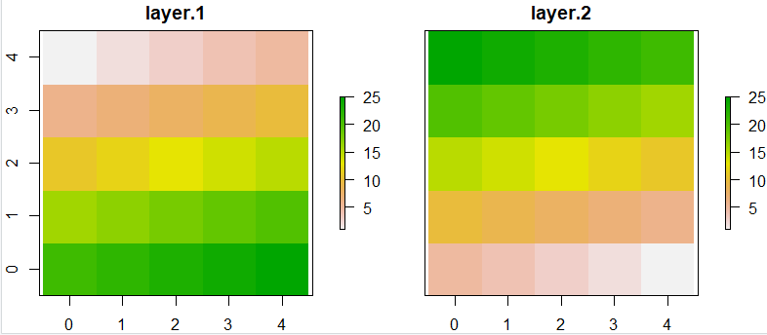
R classes for the landscape: worldMatrix and worldArray
Code available on R file: 3_NetLogoR.R
The worldArray class is a collection of several worldMatrix objects with the same extent stacked together. It is used to keep more than one value per patch
worldArray can be viewed as a mix between an array and a RasterStack
> w1 <- createWorld(minPxcor = 0, maxPxcor = 4, minPycor = 0, maxPycor = 4, data = 1:25)
> w2 <- createWorld(minPxcor = 0, maxPxcor = 4, minPycor = 0, maxPycor = 4, data = 25:1)
> w3 <- stackWorlds(w1, w2)
> plot(w3)
> w3@.Data
, , w1
[,1] [,2] [,3] [,4] [,5]
[1,] 1 2 3 4 5
[2,] 6 7 8 9 10
[3,] 11 12 13 14 15
[4,] 16 17 18 19 20
[5,] 21 22 23 24 25
, , w2
[,1] [,2] [,3] [,4] [,5]
[1,] 25 24 23 22 21
[2,] 20 19 18 17 16
[3,] 15 14 13 12 11
[4,] 10 9 8 7 6
[5,] 5 4 3 2 1

Slide 18
R classes for the landscape: worldMatrix and worldArray
By default the world is bounded (not « wrapped »). But you can make the world a torus so that when a turtle moves past the edge of the world, it disappears and reappears on the opposite edge. This option is an argument in some functions.
plot(nameWorld) works with both worldMatrix and worldArray. To visualize only one layer of a worldArray, use plot(nameWorldArray[[layerNumber]]) or plot(nameWorldArray[["layerName"]]).

Slide 19
R classes for the landscape: worldMatrix and worldArray - exercise
Create a 3-layer world of 15 patches
The 1st layer where all patches are equal to 12 (e.g., temperature)
The 2nd layer where patches are either 1 or 2, randomly (e.g., habitat type)
The 3rd layer where patches are equal to their pxcor (e.g., transect number)
Plot the 3 layers
Plot only the 2nd layer
Exercise solutions: 4_WorldExercise.R

Slide 20
R class for the mobile agents: agentMatrix
Code available on R file: 3_NetLogoR.R
AgentMatrix is an object of length n (nrows = number of turtles) with data for the turtles being: xcor, ycor, who, heading, prevX, prevY, breed, and color by default.
Turtles are the moving agents.
Turtles exist in a worldMatrix.
> t1 <- createTurtles(n = 10, coords = randomXYcor(w1, n = 10))
> t1
who heading prevX prevY breed color
1 0 2.644112 NA NA turtle #FF0000FF
2 1 320.563929 NA NA turtle #FF9900FF
3 2 192.412396 NA NA turtle #CCFF00FF
4 3 155.435898 NA NA turtle #33FF00FF
5 4 167.149854 NA NA turtle #00FF66FF
6 5 68.437296 NA NA turtle #00FFFFFF
7 6 170.062184 NA NA turtle #0066FFFF
8 7 155.778326 NA NA turtle #3300FFFF
9 8 5.429264 NA NA turtle #CC00FFFF
10 9 57.866792 NA NA turtle #FF0099FF

Slide 21
R class for the mobile agents: agentMatrix
Code available on R file: 3_NetLogoR.R
> t1
who heading prevX prevY breed color
1 0 2.644112 NA NA turtle #FF0000FF
2 1 320.563929 NA NA turtle #FF9900FF
3 2 192.412396 NA NA turtle #CCFF00FF
4 3 155.435898 NA NA turtle #33FF00FF
5 4 167.149854 NA NA turtle #00FF66FF
6 5 68.437296 NA NA turtle #00FFFFFF
7 6 170.062184 NA NA turtle #0066FFFF
8 7 155.778326 NA NA turtle #3300FFFF
9 8 5.429264 NA NA turtle #CC00FFFF
10 9 57.866792 NA NA turtle #FF0099FF
> t1@.Data
xcor ycor who heading prevX prevY breed color
[1,] -0.45613 2.85397 0 66.29879 NA NA 1 8
[2,] 0.69175 2.08783 1 337.10566 NA NA 1 10
[3,] 3.45043 4.40191 2 311.12937 NA NA 1 7
[4,] -0.40015 1.61013 3 278.62921 NA NA 1 5
[5,] 2.89419 2.87709 4 321.40054 NA NA 1 2
[6,] 2.82283 2.91621 5 85.45662 NA NA 1 3
[7,] -0.03122 0.35232 6 87.58605 NA NA 1 1
[8,] 1.26644 1.83430 7 169.65826 NA NA 1 4
[9,] 2.79047 2.77146 8 177.33894 NA NA 1 6
[10,] 3.30077 2.63409 9 353.81830 NA NA 1 9

Slide 22
R class for the mobile agents: agentMatrix
Code available on R file: 3_NetLogoR.R
New “characteristics” can be added to the turtles.
> t1 <- turtlesOwn(turtles = t1, tVar = "sex",
tVal = c("F", "F", "F", "F", "F", "F", "M", "M", "M", "M"))
> t1
who heading prevX prevY breed color sex
1 0 2.644112 NA NA turtle #FF0000FF F
2 1 320.563929 NA NA turtle #FF9900FF F
3 2 192.412396 NA NA turtle #CCFF00FF F
4 3 155.435898 NA NA turtle #33FF00FF F
5 4 167.149854 NA NA turtle #00FF66FF F
6 5 68.437296 NA NA turtle #00FFFFFF F
7 6 170.062184 NA NA turtle #0066FFFF M
8 7 155.778326 NA NA turtle #3300FFFF M
9 8 5.429264 NA NA turtle #CC00FFFF M
10 9 57.866792 NA NA turtle #FF0099FF M

Slide 23
R class for the mobile agents: agentMatrix - exercise
Create a population of 10 individuals, all at the location [0;0] and with their heading either North or South, randomly
Give them all an age of 5
Give them a sex “male” or “female” randomly
Exercise solutions: 5_TurtlesExercise.R

Slide 24
Agents: turtles or patches
Turtles are moving agents. Turtles are represented with an agentMatrix.
Patches are non-moving agents. Patches are cells of a world. Patches are represented with a 2-column matrix with pxcor and pycor columns (i.e., coordinates of their center).
Turtles coordinates can have decimals (i.e., can be anywhere on the patches). Patches coordinates are always integer.

Slide 25
Agentset
An “agentset” is a set of agents.
Agentsets contain only some patches or some turtles. An agentset cannot contain the two agent types (patches and turtles) at once.
A patch agentset is a matrix that contains patches coordinates; a turtle agentset is an agentMatrix object containing turtles.
Agentsets can then be passed on as arguments in functions. Agentsets can be redefined at any time.
For turtles, agents and agentset are the same.

Slide 26
Agentset for turtles
Code available on R file: 3_NetLogoR.R
Create 5 sheep and 5 wolves
> t2 <- createTurtles(world = w1, n = 10, breed = c(rep("sheep", 5),
rep("wolf", 5)))
> sheep <- NLwith(agents = t2, var = "breed", val = "sheep")
> wolves <- NLwith(agents = t2, var = "breed", val = "wolf")
> sheep <- createTurtles(world = w1, n = 5, breed = "sheep")
> wolves <- createTurtles(world = w1, n = 5, breed = "wolf")

Slide 27
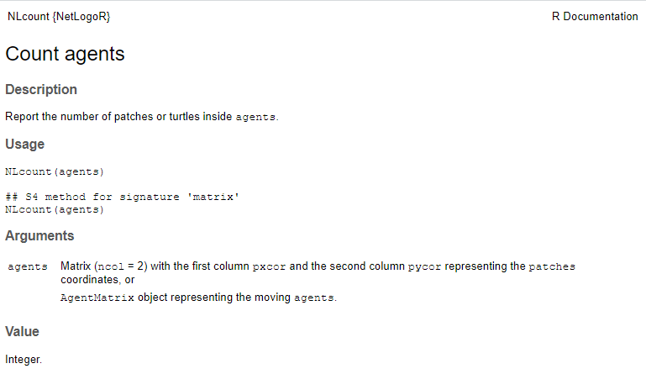
Functions
NetLogoR functions can act (modify or use) worlds (worldMatrix, worldArray), patches (2-column matrix) and/or turtles (agentMatrix).

Slide 28
Functions
Function name | Description | Topic
bk | Move backward | Movement
canMove | Can the turtles move? | Movement
cellFromPxcorPycor | Cells numbers from patches coordinates
clearPatches | Clear world’s patches
createOTurtles | Create ordered turtles | Population dynamics
createTurtles | Create turtles | Population dynamics
createWorld | Create a world
die | Kill turtles | Population dynamics
diffuse | Diffuse values in a world
downhill | Move downhill | Movement
dx | x-increment
dy | y-increment
face | Face something | Movement
fd | Move forward | Movement
hatch | Hatch new turtles | Population dynamics

Slide 29
Functions
Function name | Description | Topic
home | Return home | Movement
inCone | Agents in cone | Selection
inRadius | Agents in radius | Selection
inspect | Inspect turtles
isNLclass | Type of object
layoutCircle | Layout turtles on a circle | Movement
left | Rotate to the left | Movement
maxNof | N agents with maximum | Selection
maxOneOf | One agent with maximum | Selection
maxPxcor | Maximum pxcor
maxPycor | Maximum pycor
minNof | N agents with minimum | Selection
minOneOf | One agent with minimum | Selection
minPxcor | Minimum pxcor
minPycor | Minimum pycor

Slide 30
Functions
Function name | Description | Topic
moveTo | Move to | Movement
neighbors | Neighbors patches | Selection
NLall | All agents?
NLany | Any agents?
NLcount | Count agents
NLdist | Distances between agents
NLset | Set an agents variable
NLwith | Agents with | Selection
NLworldIndex | WorldMatrix indices from vector indices
nOf | N random agents | Selection
noPatches | No patches
noTurtles | No turtles
of | Values of an agents variable
oneOf | One random agent | Selection
other | Others | Selection

Slide 31
Functions
Function name | Description | Topic
patch | Patches coordinates
patchAhead | Patches ahead | Selection
patchAt | Patches at | Selection
patchDistDir | Patches at given distances and directions | Selection
patches | All the patches in a world | Selection
patchHere | Patches here | Selection
patchLeft | Patches on the left | Selection
patchRight | Patches on the right | Selection
patchSet | Patch set
pExist | Do the patches exist?
PxcorPycorFromCell | Patches coordinates from cells numbers
randomPxcor | Random pxcor
randomPycor | Random pycor
randomXcor | Random xcor
randomXYcor | Random turtles coordinates

Slide 32
Functions
Function name | Description | Topic
randomYcor | Random ycor
raster2world | Convert a Raster* object into a worldMatrix or worldArray object
right | Rotate to the right | Movement
setXY | Set turtles’ locations | Movement
sortOn | Sort agents
spdf2turtles | From SpatialPointsDataFrame to agentMatrix
sprout | Sprout new turtles | Population dynamics
stackWorlds | Stack worlds
subHeadings | Subtract headings
tExist | Do the turtle exist?
towards | Directions towards | Movement
turtle | Select turtles | Selection
turtles2spdf | From agentMatrix to SpatialPointsDataFrame
turtlesAt | Turtles at | Selection
turtleSet | Create a turtle agentset | Selection

Slide 33
Functions
Function name | Description | Topic
turtlesOn | Turtles on | Selection
turtlesOwn | New turtles variable
uphill | Move uphill | Movement
withMax | Agents with maximum | Selection
withMin | Agents with minimum | Selection
world2raster | Convert a worldMatrix or worldArray object into a Raster* object
worldHeight | World height
worldWidth | World width

Slide 34
NetLogoR
Resources
Beginner guide http://netlogor.predictiveecology.org/articles/ProgrammingGuide.html
Dictionnary NetLogo <=> NetLogoR http://netlogor.predictiveecology.org/articles/NLR-Dictionary.html
3 model examples
Butterfly Hilltopping
Ants
Wolf Sheep Predation

Slide 35

Butterfly hilltopping
Repeat
Butterflies
Habitat
MOVEMENT
Railsback and Grimm, 2012

Slide 36
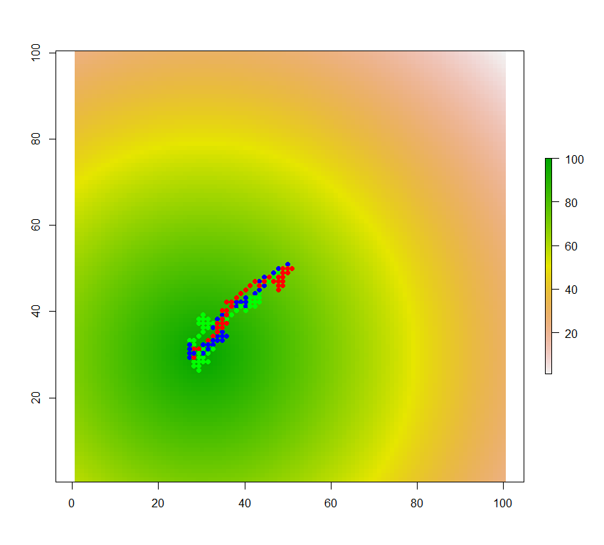
Butterfly hilltopping = IBM
MOVEMENT
Rules at the individual level
Emergence of patterns at the population level
E.g., migration route
Railsback and Grimm, 2012

Slide 37
Butterfly hilltopping = SE-IBM
Influence of the environment in the individual’s decisions
Repeat
Butterflies
Habitat
MOVEMENT
Railsback and Grimm, 2012

Slide 38
Butterfly hilltopping
A butterfly moving uphill on a gridded landscape with a hill, one cell at the time
p = 0.5, move uphill
move to their neighboring cell with the highest elevation value
p = 0.5, move randomly
move to one of their neighboring cells without preference
Railsback and Grimm, 2012

Slide 39
Butterfly hilltopping
MOVEMENT
Fly up
p = 0.5
Fly randomly
p = 0.5
Railsback and Grimm, 2012

Slide 40
Butterfly hilltopping
MOVEMENT
Fly up
p = 0.5
Habitat
Railsback and Grimm, 2012

Slide 41
Butterfly hilltopping
MOVEMENT
Fly randomly
p = 0.5
1/8
1/8
1/8
1/8
1/8
1/8
1/8
1/8
Railsback and Grimm, 2012

Slide 42
Butterfly hilltopping
MOVEMENT
Repeat for each individual
At each time step
Fly up
p = 0.5
Fly randomly
p = 0.5
1/8
1/8
1/8
Habitat
1/8
1/8
1/8
1/8
1/8
Railsback and Grimm, 2012

Slide 43
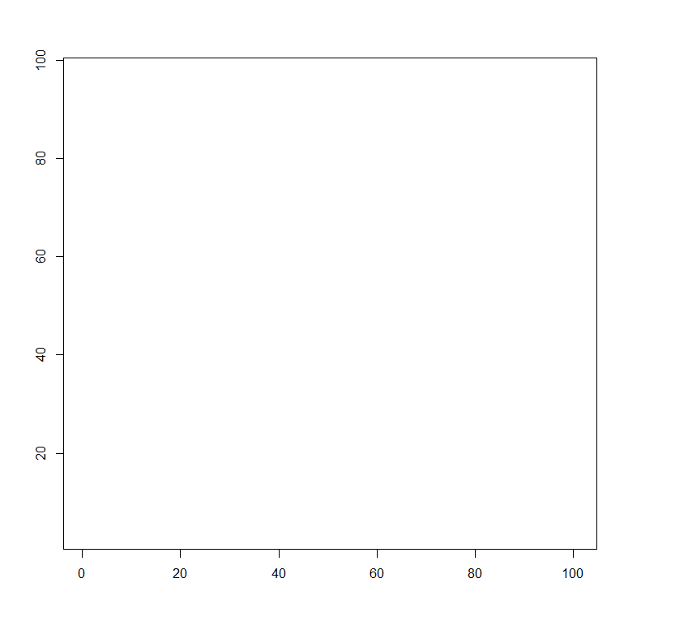
hill <- createWorld(minPxcor = 1, maxPxcor = 100, minPycor = 1, maxPycor = 100)
elevation <- 100 - NLdist(agents = patches(hill),
agents2 = cbind(x = 30, y = 30))
hill <- NLset(world = hill, agents = patches(hill), val = elevation)
plot(hill)
b3 <- createTurtles(n = 3, coords = cbind(xcor = 50, ycor = 50))
points(b3, pch = 16, col = of(agents = b3, var = "color"))
for (time in 1:100) {
if (runif(n = 1, min = 0, max = 1) < 0.5) {
b3 <- uphill(world = hill, turtles = b3, nNeighbors = 8)
} else {
allNeighbors <- neighbors(world = hill, agents = b3, nNeighbors = 8)
oneNeighbor <- oneOf(allNeighbors)
b3 <- moveTo(turtles = b3,
agents = oneNeighbor)
}
points(b3, pch = 16,
col = of(agents = b3,
var = "color"))
}
Full code with comments available: 6_ButterflyHilltopping.R

Slide 44
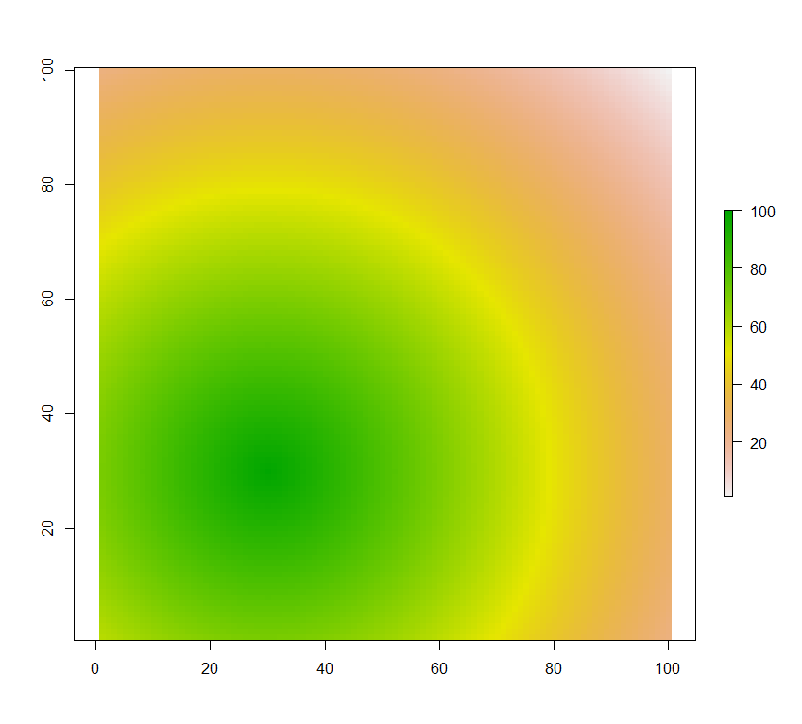
hill <- createWorld(minPxcor = 1, maxPxcor = 100, minPycor = 1, maxPycor = 100)
elevation <- 100 - NLdist(agents = patches(hill), agents2 = cbind(x = 30, y = 30))
hill <- NLset(world = hill, agents = patches(hill), val = elevation)
plot(hill)
b3 <- createTurtles(n = 3, coords = cbind(xcor = 50, ycor = 50))
points(b3, pch = 16, col = of(agents = b3, var = "color"))
for (time in 1:100) {
if (runif(n = 1, min = 0, max = 1) < 0.5) {
b3 <- uphill(world = hill, turtles = b3, nNeighbors = 8)
} else {
allNeighbors <- neighbors(world = hill, agents = b3, nNeighbors = 8)
oneNeighbor <- oneOf(allNeighbors)
b3 <- moveTo(turtles = b3,
agents = oneNeighbor)
}
points(b3, pch = 16,
col = of(agents = b3,
var = "color"))
}
Full code with comments available: 6_ButterflyHilltopping.R

Slide 45

hill <- createWorld(minPxcor = 1, maxPxcor = 100, minPycor = 1, maxPycor = 100)
elevation <- 100 - NLdist(agents = patches(hill), agents2 = cbind(x = 30, y = 30))
hill <- NLset(world = hill, agents = patches(hill), val = elevation)
plot(hill)
b3 <- createTurtles(n = 3, coords = cbind(xcor = 50, ycor = 50))
points(b3, pch = 16, col = of(agents = b3, var = "color"))
for (time in 1:100) {
if (runif(n = 1, min = 0, max = 1) < 0.5) {
b3 <- uphill(world = hill, turtles = b3, nNeighbors = 8)
} else {
allNeighbors <- neighbors(world = hill, agents = b3, nNeighbors = 8)
oneNeighbor <- oneOf(allNeighbors)
b3 <- moveTo(turtles = b3,
agents = oneNeighbor)
}
points(b3, pch = 16,
col = of(agents = b3,
var = "color"))
}
Full code with comments available: 6_ButterflyHilltopping.R

Slide 46
hill <- createWorld(minPxcor = 1, maxPxcor = 100, minPycor = 1, maxPycor = 100)
elevation <- 100 - NLdist(agents = patches(hill), agents2 = cbind(x = 30, y = 30))
hill <- NLset(world = hill, agents = patches(hill), val = elevation)
plot(hill)
b3 <- createTurtles(n = 3, coords = cbind(xcor = 50, ycor = 50))
points(b3, pch = 16, col = of(agents = b3, var = "color"))
for (time in 1:100) {
if (runif(n = 1, min = 0, max = 1) < 0.5) {
b3 <- uphill(world = hill, turtles = b3, nNeighbors = 8)
} else {
allNeighbors <- neighbors(world = hill, agents = b3, nNeighbors = 8)
oneNeighbor <- oneOf(allNeighbors)
b3 <- moveTo(turtles = b3, agents = oneNeighbor)
}
points(b3, pch = 16, col = of(agents = b3, var = "color"))
}
Full code with comments available: 6_ButterflyHilltopping.R

Slide 47
hill <- createWorld(minPxcor = 1, maxPxcor = 100, minPycor = 1, maxPycor = 100)
elevation <- 100 - NLdist(agents = patches(hill), agents2 = cbind(x = 30, y = 30))
hill <- NLset(world = hill, agents = patches(hill), val = elevation)
plot(hill)
b3 <- createTurtles(n = 3, coords = cbind(xcor = 50, ycor = 50))
points(b3, pch = 16, col = of(agents = b3, var = "color"))
for (time in 1:100) {
if (runif(n = 1, min = 0, max = 1) < 0.5) {
b3 <- uphill(world = hill, turtles = b3, nNeighbors = 8)
} else {
allNeighbors <- neighbors(world = hill, agents = b3, nNeighbors = 8)
oneNeighbor <- oneOf(allNeighbors)
b3 <- moveTo(turtles = b3, agents = oneNeighbor)
}
points(b3, pch = 16, col = of(agents = b3, var = "color"))
}
Full code with comments available: 6_ButterflyHilltopping.R

Slide 48
hill <- createWorld(minPxcor = 1, maxPxcor = 100, minPycor = 1, maxPycor = 100)
elevation <- 100 - NLdist(agents = patches(hill), agents2 = cbind(x = 30, y = 30))
hill <- NLset(world = hill, agents = patches(hill), val = elevation)
plot(hill)
b3 <- createTurtles(n = 3, coords = cbind(xcor = 50, ycor = 50))
points(b3, pch = 16, col = of(agents = b3, var = "color"))
for (time in 1:100) {
if (runif(n = 1, min = 0, max = 1) < 0.5) {
b3 <- uphill(world = hill, turtles = b3, nNeighbors = 8)
} else {
allNeighbors <- neighbors(world = hill, agents = b3, nNeighbors = 8)
oneNeighbor <- oneOf(allNeighbors)
b3 <- moveTo(turtles = b3, agents = oneNeighbor)
}
points(b3, pch = 16, col = of(agents = b3, var = "color"))
}
Full code with comments available: 6_ButterflyHilltopping.R

Slide 49
hill <- createWorld(minPxcor = 1, maxPxcor = 100, minPycor = 1, maxPycor = 100)
elevation <- 100 - NLdist(agents = patches(hill), agents2 = cbind(x = 30, y = 30))
hill <- NLset(world = hill, agents = patches(hill), val = elevation)
plot(hill)
b3 <- createTurtles(n = 3, coords = cbind(xcor = 50, ycor = 50))
points(b3, pch = 16, col = of(agents = b3, var = "color"))
for (time in 1:100) {
if (runif(n = 1, min = 0, max = 1) < 0.5) {
b3 <- uphill(world = hill, turtles = b3, nNeighbors = 8)
} else {
allNeighbors <- neighbors(world = hill, agents = b3, nNeighbors = 8)
oneNeighbor <- oneOf(allNeighbors)
b3 <- moveTo(turtles = b3, agents = oneNeighbor)
}
points(b3, pch = 16, col = of(agents = b3, var = "color"))
}
Full code with comments available: 6_ButterflyHilltopping.R

Slide 50
Butterfly hilltopping - exercise
Butterflies are 50 instead of 3
They start at the top of the hill
They follow the same movement pattern but they fly downhill
Exercise solutions: 7_ButterflyHilltoppingExercise.R

Slide 51
Butterfly hilltopping
Plotting all positions slows the model
All butterflies follow the same rules (uphill or randomly) at each time step
Do the runif() for each butterfly to assign a different movement
Uphill = Move the turtles to their neighboring patch with the highest value
Downhill = Move the turtles to their neighboring patch with the lowest value

Slide 52
NetLogoR A more complex model

Slide 53
Wolf Sheep Predation
Prey-predator system
2 types of moving individuals
Interactions individual/individual

Slide 55
Wolf Sheep Predation
Prey-predator system
2 types of moving individuals
Interactions individual/individual
Interactions individual/landscape

Slide 57
Wolf Sheep Predation
Prey-predator system
2 types of moving individuals
Interactions individual/individual
Interactions individual/landscape
Full model available when downloading NetLogoR
Let’s look at a simpler version: 8_WolfSheep.R

Slide 58
References
NetLogoR
Bauduin S, McIntire EJB, Chubaty AM. 2019. NetLogoR: a package to build and run spatially explicit agent‐based models in R. Ecography 42:1841–1849.
NetLogo
Wilensky U. 1999. NetLogo. Center for Connected Learning and Computer-Based Modeling, Northwestern University, Evanston, IL. Available from http://ccl.northwestern.edu/netlogo/.

